Slide 1

Agile Methodology and Scum Framework Migration Plan
Joshua Williamson
CS-250
12/10/2024

Slide 2

Scrum-Agile Roles
Team day to day roles as part of Migration plan changes.

Slide 3

What is Agile?
Agile is a flexible and collaborative approach to Project Management as well as Product Development. Agile focuses on delivering value incrementally by breaking the tasks into smaller and manageable pieces. Agile also prioritizes customer feedback and enables teams to adapt quickly to changes based on customers evolving needs.
Collaboration is central to Agile with cross-functional trams working closely with customers and stakeholders. Agile emphasizes continuous improvement through regular reflection on processes and outcomes.
Key principles include delivering work solutions frequently, maintain transparency, and holding teams accountable. Agile can reduce risks by encouraging incremental progress and regular testing. It can also help teams stay adaptable and responsible to ensure higher customer satisfaction.

Slide 4

Scrum-Agile Team Roles: Product Owner
Product Owner
Serves as the voice of the business.
Focused on maximizing the team's output value.
Oversees and manages the product backlog effectively.
Ensures backlog items are clearly defined and understood by the team.
Prioritizes tasks to align with objectives and deliver the mission.
Keeps the backlog transparent and accessible to all stakeholders.
Communicates the team's upcoming work priorities.
Responsibilities include:
Defining the Product Vision by outlining the vision and to create and maintain the product backlog.
Managing the Product Backlog by prioritizing the backlog items based on business values and stakeholder needs.
Prioritizing needs by prioritizing features that bring the most value.
Overseeing Development stages of development from planning to refinement based on feedback.
Anticipating the client's needs by understanding the client's needs and market trends.

Slide 5

Scrum-Agile Team Roles: Developers
Developers
Dedicated to delivering a functional component at the end of each Sprint.
Responsibilities include:
Planning the Sprint and managing the Sprint Backlog.
Ensuring quality by following the Definition of Done.
Adjusting their plans daily to stay aligned with the Sprint Goal.
Holding themselves and each other accountable as professionals.
Retaining the skills needed to develop the product independently.
Operating as a self-organizing unit, deciding how to transform the backlog into working functionality without external direction.

Slide 6

Scrum-Agile Team Roles: Scrum Master
Scrum Master
Responsible for ensuring Scrum is implemented as outlined in the Scrum Guide.
Accountable for improving the Scrum Team's overall effectiveness.
Acts as a servant leader, supporting the Scrum Team and the organization.
Coaches team members in self-management and cross-functionality.
Assists in producing high-value work that meets the Definition of Done.
Removes obstacles that hinder team progress and resolves issues between stakeholders and the team.
Ensures all Scrum events occur as planned, remain productive, positive, and on track.
Responsibilities include:
Guides the team in defining Product Goals and managing the Product Backlog effectively.
Supports the Product Owner in crafting clear and concise backlog items.
Helps establish strategic product planning in complex environments.
Facilitates collaboration between stakeholders and the Scrum Team as needed.
Leads and trains the organization in adopting Scrum practices.
Advises on planning and implementing Scrum within the organization.
Respects the team’s autonomy by avoiding excessive direction, allowing them to self-organize.

Slide 7
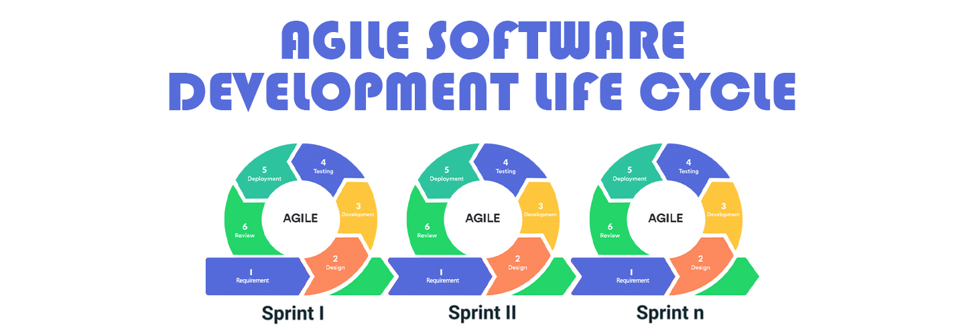
SDLC phases with a new Agile Approach
The Agile methodology for the Software Development Life Cycle involves development phases that operate in a continuous loop. Unlike a traditional SDLC, which begins with planning and concludes when all features are built and the product is ready for delivery, Agile treats each feature as an independent cycle of development.
In Agile, features are divided into user "stories" that are developed in iterative cycles called "sprints." Each sprint follows a repetitive sequence of phases, which can be repeated as needed until the feature or group of features is finalized.

Slide 8
Phases of the Software Development
Requirements and Analysis
Software Design
Implementation and Development
Integration and Testing
Deployment
Maintenance

Slide 9
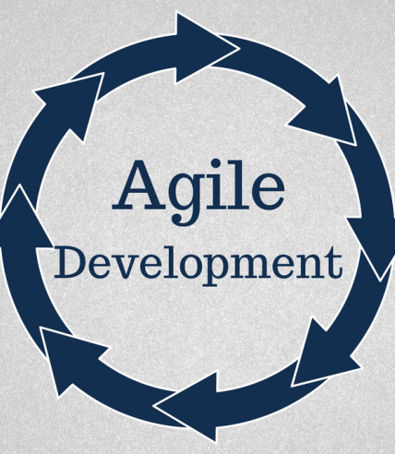
Development Cycle: Agile View
Requirement Analysis
Objective: Understand and document the software needs of the stakeholders.
Activities:
Gather requirements through meetings, interviews, and surveys.
Analyze and prioritize requirements.
Create requirement specifications and use cases.
System Design
Objective: Create a blueprint for the software system.
Activities:
Define the overall system architecture.
Design databases, user interfaces, and application modules.
Specify hardware and software requirements.
Implementation (Coding)
Objective: Translate design into a functional system by writing code.
Activities:
Assign tasks to developers.
Write and document code using programming languages.
Conduct unit testing to ensure each module works independently.

Slide 10
Development Cycle: Agile View
Integration and Testing
Objective: Verify that the system functions as intended when all components work together.
Activities:
Integrate individual modules.
Conduct functional, system, and performance testing.
Fix defects and re-test.
Deployment
Objective: Deliver the software to the end-users for use.
Activities:
Deploy the system to the production environment.
Perform installation and configuration.
Provide initial user support and training.
Maintenance
Objective: Ensure the software continues to perform well and meets evolving requirements.
Activities:
Monitor the software for issues.
Perform updates, bug fixes, and patches.
Add new features as per user feedback or changes in requirements.

Slide 11
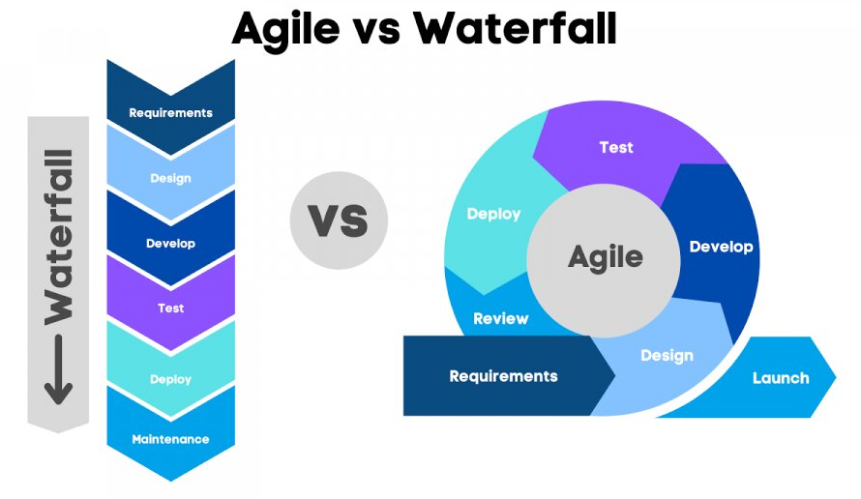
Using the Waterfall Model for Product Development
In the Waterfall approach, changes are difficult to accommodate because requirements are fixed early, and the process is strictly sequential. If a problem, such as a confusing feature, arises later, it requires revisiting earlier phases like design and implementation, leading to delays and added costs. Addressing such issues involves formal approvals and extensive rework, often resulting in postponed fixes or subpar user satisfaction.
In contrast, Agile is iterative and flexible, allowing problems to be identified and addressed early through continuous feedback in each sprint. Teams can quickly prioritize issues in the backlog, collaborate on solutions, and implement fixes in the next development cycle. This iterative process minimizes disruption, ensures better user satisfaction, and keeps the project on track.

Slide 12

Waterfall or Agile Approach, which is best for the company.
Factors Favoring Waterfall:
Stable Requirements: Requirements are well-defined, documented, and unlikely to change throughout the project.
Clear Milestones: The project benefits from a structured approach with clearly defined phases and deadlines.
Predictable Outcomes: The project scope and deliverables are fixed, making progress and results more predictable.
Limited Stakeholder Involvement: Minimal need for frequent feedback or collaboration from stakeholders during development.
Factors Favoring Agile:
Evolving Requirements: The project requires flexibility to adapt to changing needs or stakeholder feedback.
Frequent Iterations: Deliverables are incremental, allowing for regular testing, feedback, and improvements.
High Stakeholder Engagement: Ongoing collaboration with stakeholders is essential to refine and prioritize features.
Focus on User Experience: User feedback is critical to ensure the solution meets expectations and addresses issues early.

Slide 13
References
Agile Vs. Waterfall: Which Project Management Methodology Is Best For You? (2024)
https://www.forbes.com/advisor/business/agile-vs-waterfall-methodology/
Agile vs Waterfall Methodology: Differences & How to Choose (2024)
https://project-management.com/agile-vs-waterfall/
Agile vs Waterfall: Which Methodology To Choose? (2024)
https://thedigitalprojectmanager.com/projects/pm-methodology/agile-vs-waterfall/

